Slide 1

GOKARAJU RANGARAJU INSTITUTE OF ENGINEERING AND TECHNOLOGY
Department of Computer Science and Engineering
Major Project Phase-2 Review-2
HASH TAG PREDICTION FOR SOCIAL MEDIA
D.USHA SREE
(Assistant Professor, Dept of CSE)
GV Harshith A SAHITH
- 20241A05E7
- 20241A05C4 20241A05D6
20241A05C1
21245A0516
B SHIVA KRISHNA - A GUNATEJA - K RAVI CHANDRA -

Slide 2
GOKARAJU RANGARAJU INSTITUTE OF ENGINEERING AND TECHNOLOGY Department of Computer Science and Engineering MAJOR Project Phase-2 Review-2
Abstract:
In the age of social media, the use of hashtags has become a prevalent way for users to categorize and label their posts, facilitating content discovery and engagement. However, the manual selection of relevant hashtags for a post can be time-consuming and error-prone. To address this challenge, hashtag prediction has emerged as a valuable task in the realm of natural language processing and machine learning. The goal of hashtag prediction is to automatically suggest a set of relevant hashtags for a given piece of text, enhancing post visibility and engagement. In this project, we will create a Machine Learning model. The model will take tweets as input and separate each word of those tweets into three groups, namely “Sentiments”, “When,” and “Kind.”

Slide 3
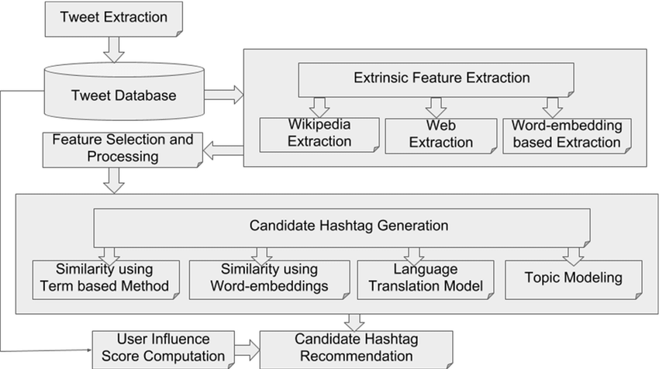
GOKARAJU RANGARAJU INSTITUTE OF ENGINEERING AND TECHNOLOGY Department of Computer Science and Engineering MAJOR Project Phase-2 Review-2
Architecture:

Slide 4
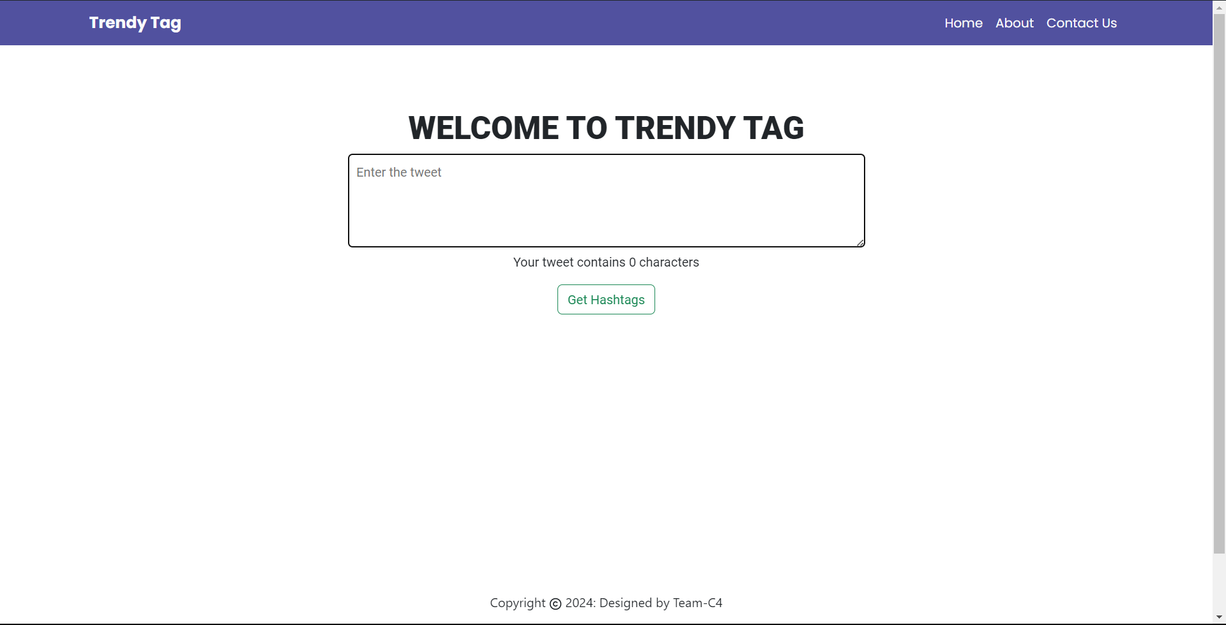
GOKARAJU RANGARAJU INSTITUTE OF ENGINEERING AND TECHNOLOGY Department of Computer Science and Engineering MAJOR Project Phase-2 Review-2
GUI(Graphical User Interface):

Slide 5
GOKARAJU RANGARAJU INSTITUTE OF ENGINEERING AND TECHNOLOGY Department of Computer Science and Engineering MAJOR Project Phase-2 Review-2
Components of the GUI:
Input Text Area:
A text box where users can input the text for which they want to generate hashtags.
Generate Button:
A button that, when clicked, triggers the hashtag generation process based on the input text.
Hashtag Results Area:
A display area where generated hashtags will appear after the user clicks the "Generate" button.
4.About :
A button that shows the information of the website and it also explains about how to use it. It serves as an informative resource, providing a clear overview of what the website aims to achieve and how it can benefit users.

Slide 6
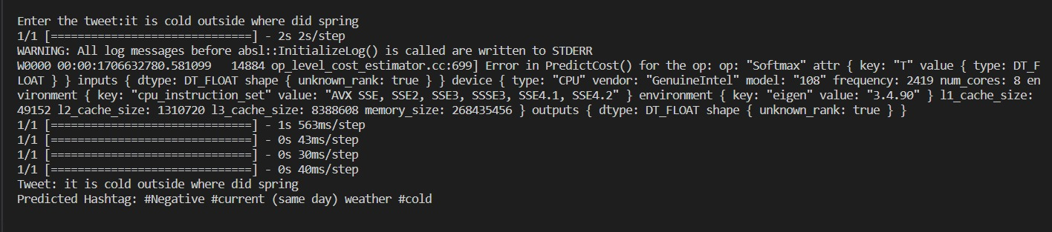
GOKARAJU RANGARAJU INSTITUTE OF ENGINEERING AND TECHNOLOGY Department of Computer Science and Engineering MAJOR Project Phase-2 Review-2
Result:

Slide 7
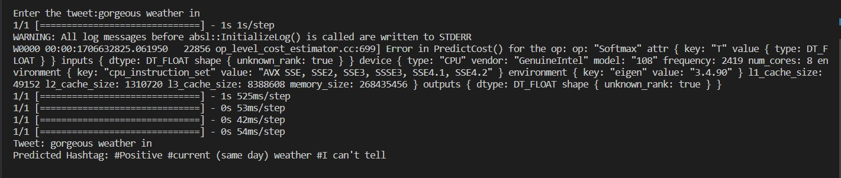
GOKARAJU RANGARAJU INSTITUTE OF ENGINEERING AND TECHNOLOGY Department of Computer Science and Engineering MAJOR Project Phase-2 Review-2

Slide 8
GOKARAJU RANGARAJU INSTITUTE OF ENGINEERING AND TECHNOLOGY Department of Computer Science and Engineering MAJOR Project Phase-2 Review-2
Results Analysis:
The hashtag prediction model's performance and effectiveness can be initially evaluated by comparing the predicted hashtags with manually selected hashtags for a set of tweets.
Analyzing the distribution of predicted hashtags across the three categories: "Sentiments," "When," and "Kind," can offer insights into the model's proficiency in categorizing tweet content.
Evaluating user satisfaction, perceived efficiency, and overall experience with the automated hashtag recommendations through surveys or feedback collection will offer practical implications and benefits of the model.
Understanding user perspectives and experiences will be essential in assessing the model's impact on streamlining the hashtag selection process and enhancing the user experience on social media platforms.
Comprehensive analysis of the hashtag generation results, considering accuracy, distribution, engagement metrics, hashtag diversity, and user experience, will provide valuable insights into the model's performance and effectiveness in revolutionizing hashtag usage and social media interactions.

Slide 9
GOKARAJU RANGARAJU INSTITUTE OF ENGINEERING AND TECHNOLOGY Department of Computer Science and Engineering MAJOR Project Phase-2 Review-2
Publication Status:
Our paper for the project review has been submitted to the E3S conference, and we are currently awaiting their feedback.

Slide 10
GOKARAJU RANGARAJU INSTITUTE OF ENGINEERING AND TECHNOLOGY Department of Computer Science and Engineering MAJOR Project Phase-2 Review-2
Conclusion:
Our project embarked on the journey to address the challenges posed by manual hashtag selection and aimed to simplify content discoverability and enhance user interaction.
Through extensive research, implementation, and evaluation, we have reached significant milestones that underscore the importance of automated hashtag prediction.
Our approach navigated the intricacies of social media text, from deciphering informal language and ambiguous context to adapting to user variations and temporal dynamics. By harnessing the power of machine learning and natural language processing, we were able to achieve accurate hashtag predictions that resonate with content themes and user intent.
Throughout the development process, our focus remained steadfast on user-centricity, iterative refinement, and scalability to meet the evolving demands of social media platforms.

Slide 11
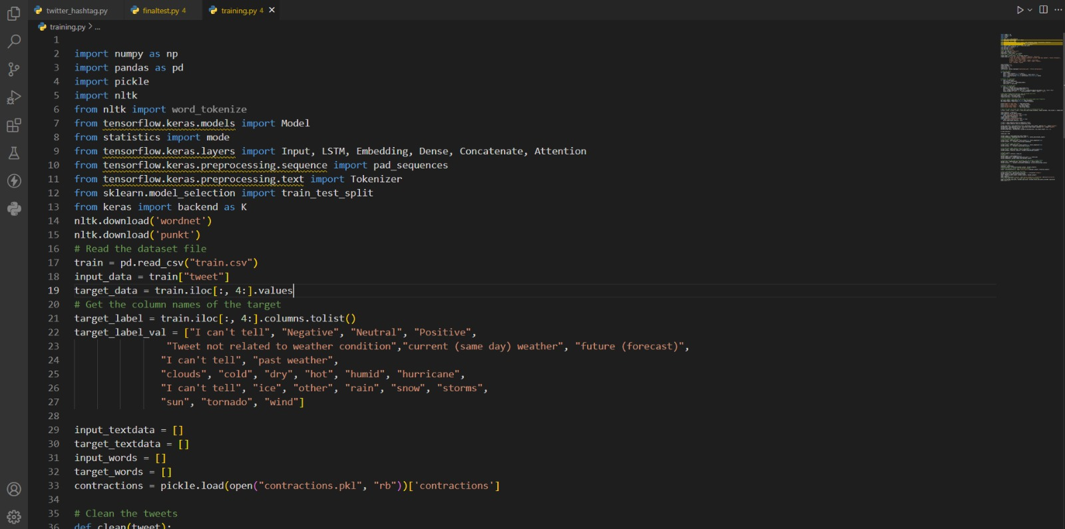
GOKARAJU RANGARAJU INSTITUTE OF ENGINEERING AND TECHNOLOGY Department of Computer Science and Engineering MAJOR Project Phase-2 Review-2
Snapshots:
Declaration and Initialization

Slide 12
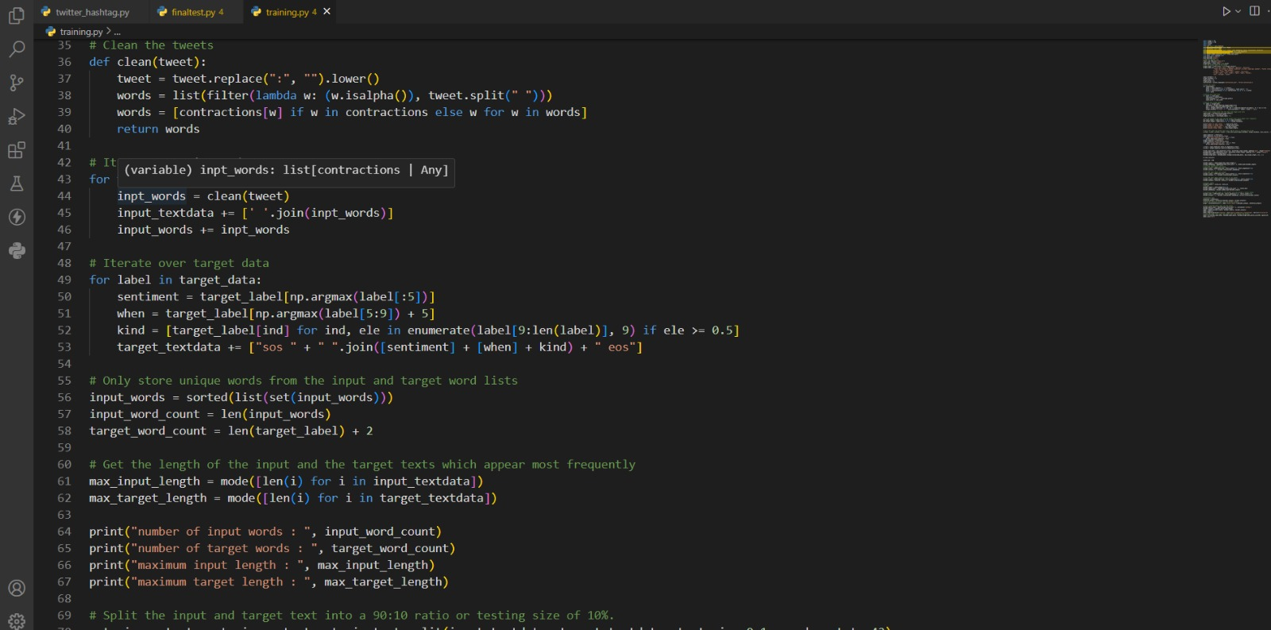
GOKARAJU RANGARAJU INSTITUTE OF ENGINEERING AND TECHNOLOGY Department of Computer Science and Engineering MAJOR Project Phase-2 Review-2
Preprocessing and Splitting the Data

Slide 13
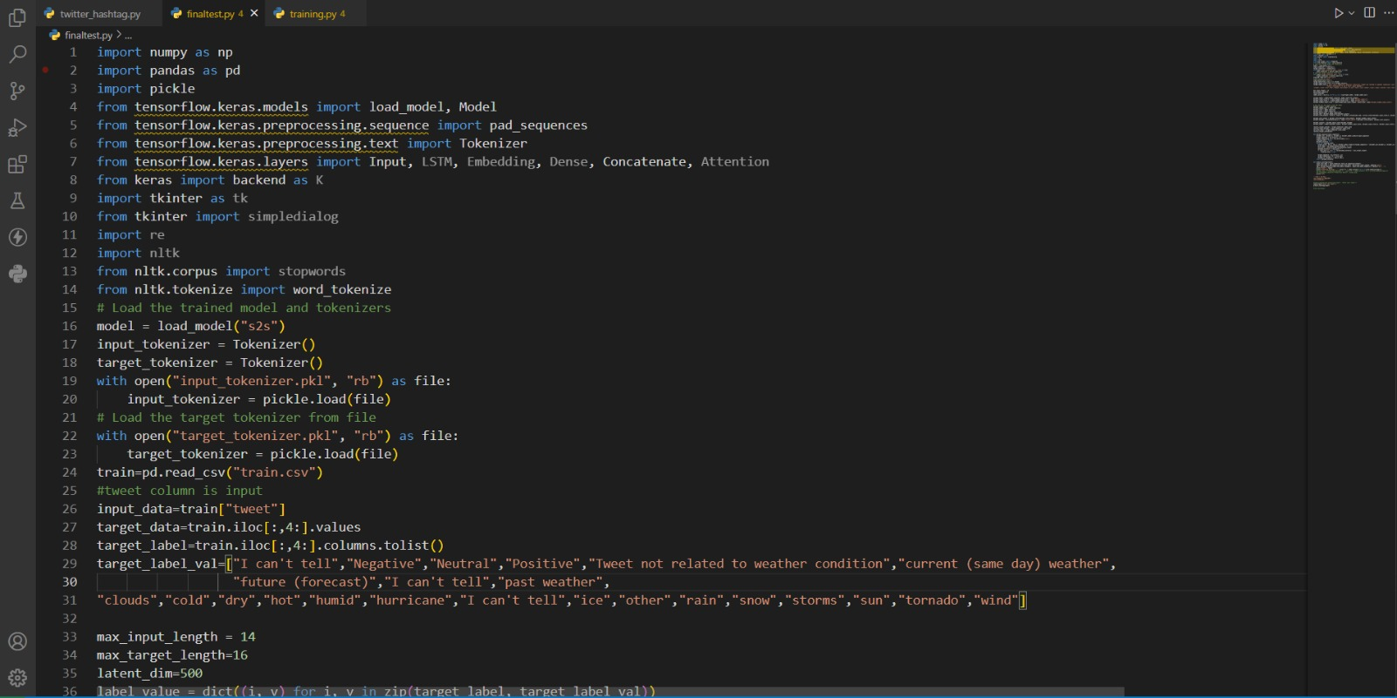
GOKARAJU RANGARAJU INSTITUTE OF ENGINEERING AND TECHNOLOGY Department of Computer Science and Engineering MAJOR Project Phase-2 Review-2
Testing with User Input

Slide 14
GOKARAJU RANGARAJU INSTITUTE OF ENGINEERING AND TECHNOLOGY Department of Computer Science and Engineering MAJOR Project Phase-2 Review-2

Slide 15
GOKARAJU RANGARAJU INSTITUTE OF ENGINEERING AND TECHNOLOGY Department of Computer Science and Engineering MAJOR Project Phase-2 Review-2

Slide 16
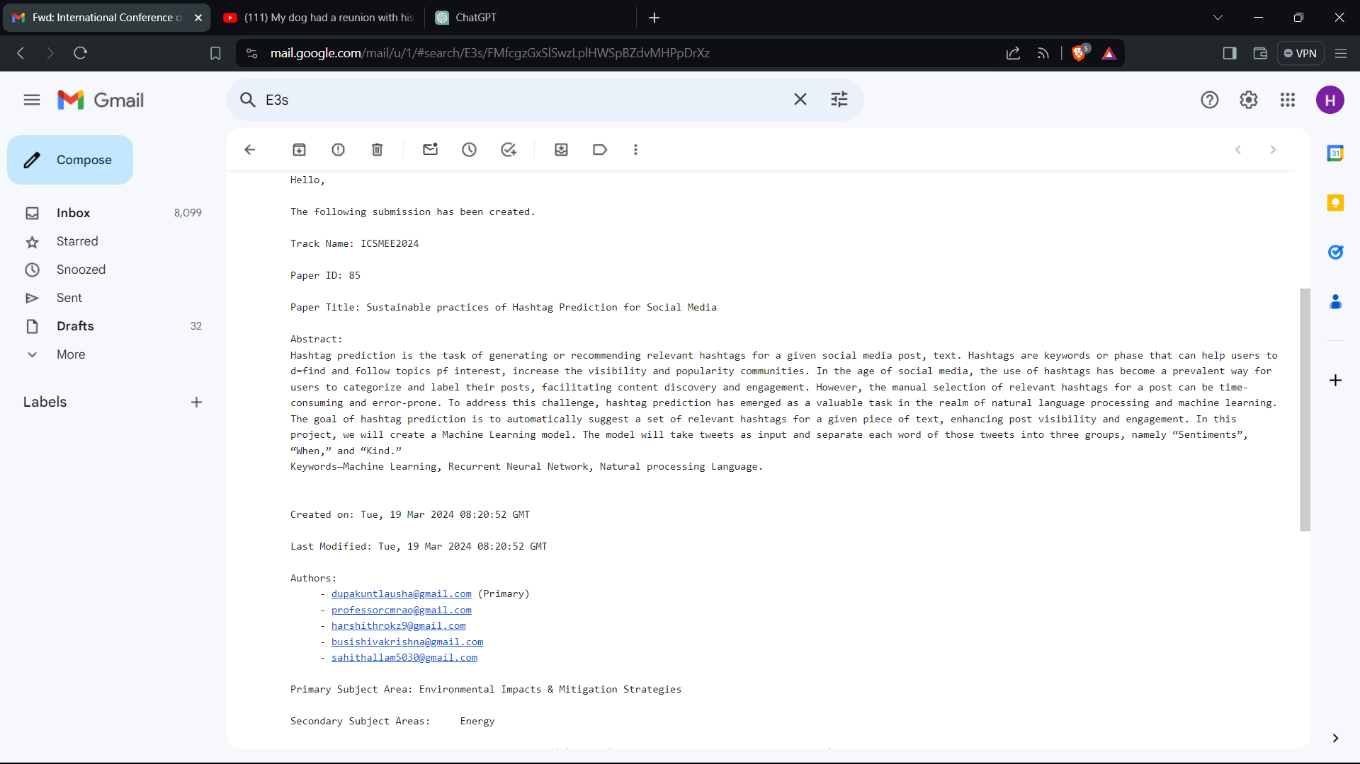
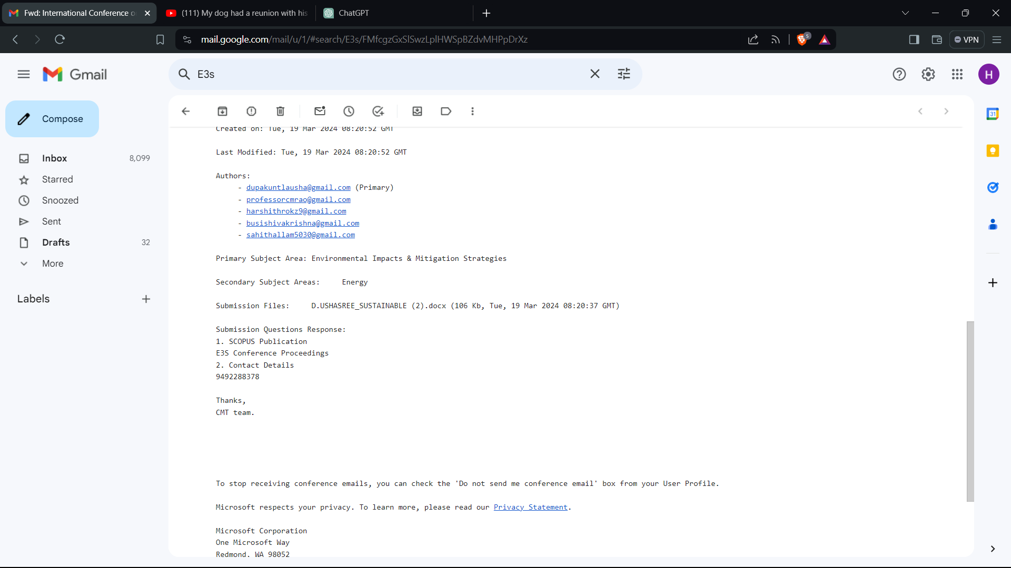
GOKARAJU RANGARAJU INSTITUTE OF ENGINEERING AND TECHNOLOGY Department of Computer Science and Engineering MAJOR Project Phase-2 Review-2
Proof for Publication:

Slide 17
GOKARAJU RANGARAJU INSTITUTE OF ENGINEERING AND TECHNOLOGY Department of Computer Science and Engineering MAJOR Project Phase-2 Review-2
THANK YOU

